Slide 1

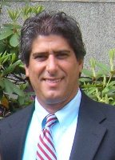

Communications Management: Promoting the Value of Your Services
Creating a communications plan for your IT organization will help define communication efforts so your message is consistent and the value of your services is clearly articulated.
What You’re Going To Learn Today:
1. How to create a communications plan the old-fashioned way
2. How how to execute your communications plan using social media.
3. Get the tools to emulate the best marketing companies in the world, right from your IT shop.
Eddie Vidal
Manager, Enterprise Support Services
University of Miami.
The Presentation Will Begin at 12:00pm EDT
The recorded presentation and slides will be available in the Thought Rock library after the show.
Thought Rock Live
Knowledge worth sharing
Thought Rock Live
Knowledge worth sharing
#TRLive
@ThoughtRockers
Thoughtrock.com

Slide 2

Communications Management:
Promoting the Value of your Service
Eddie Vidal
Manager, Enterprise Support Services
October 2, 2012
Notes:
Communications Management: Promoting the Value of Your Services
ITIL emphasizes the alignment of IT services with the business, integrating processes and improving communications. Yet it doesn’t emphasize the need for a communication plan. Have you considered defining a communication plan for your department?
Creating a communications plan for your IT organization will help define communication efforts so that your message is consistent and the value of your services is clearly articulated. In this session, learn how a communication plan can change your company’s perception of IT, enable you to promote your value, keep you on the same page as your leadership team, and keep your department aligned with the company’s goals.
Participants will learn how to create a communications plan that leverages social media and how to use the communication plan to convincing management of the importance of sending a consistent message. You will leave this session with the tools to emulate the best marketing companies in the world, right from your IT shop.
Consistent message
Communicate value
Change your perception with plan
How – proactive
Promote IT’s value
Consistent message with leadership team and business
Align communication with company goals
Use social media to leverage communication plan

Slide 3
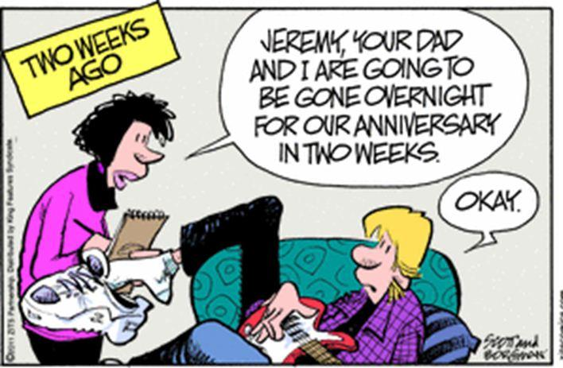
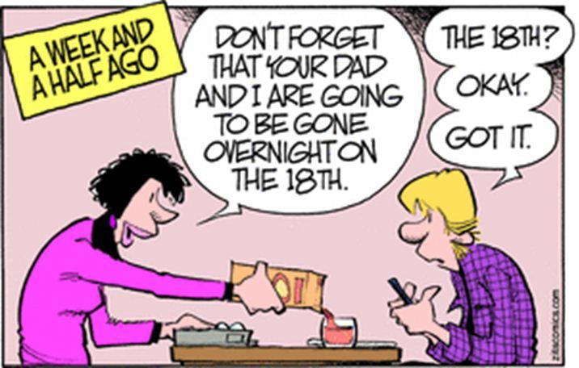
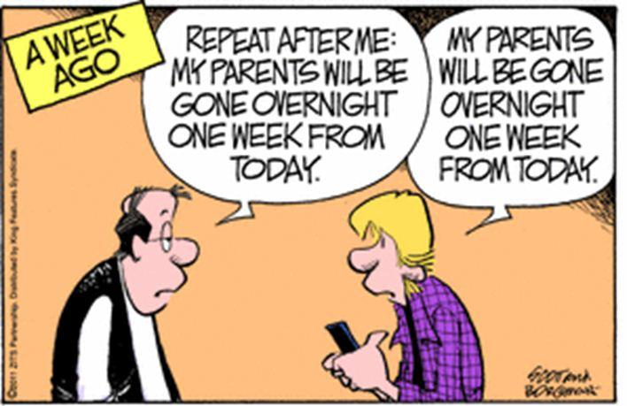
Communications 101

Slide 4
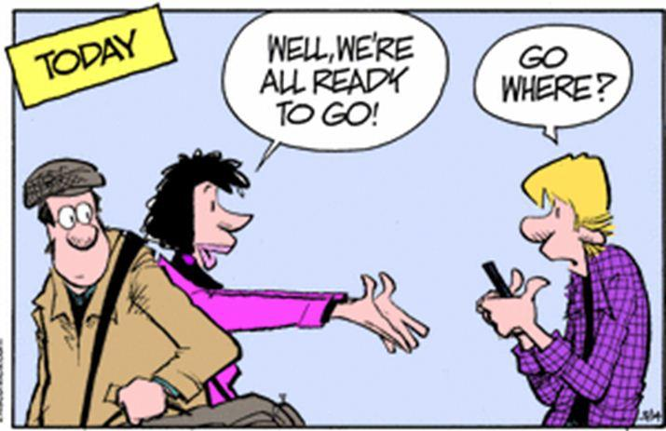
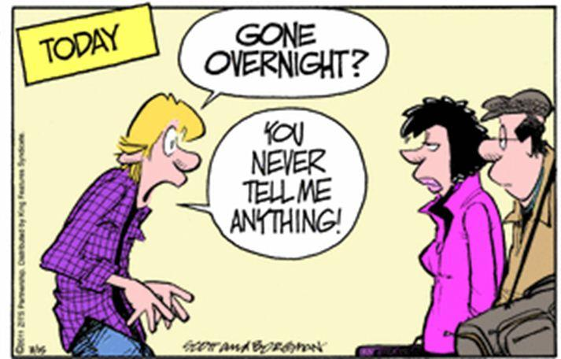
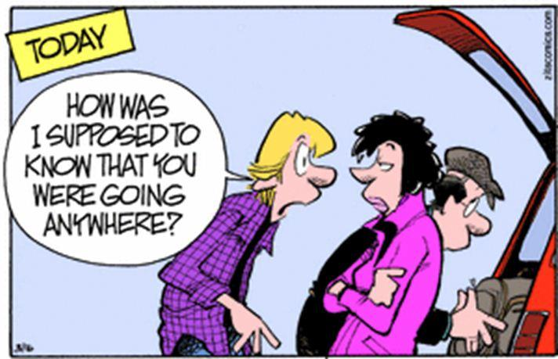
Communications 101

Slide 5
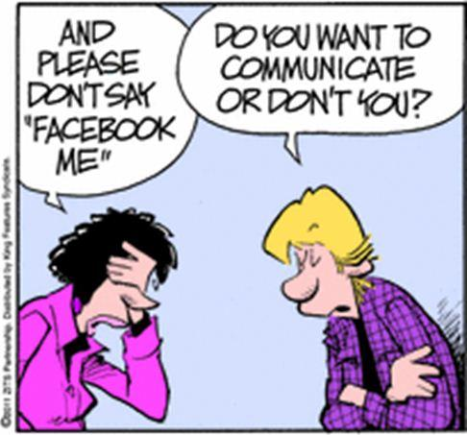
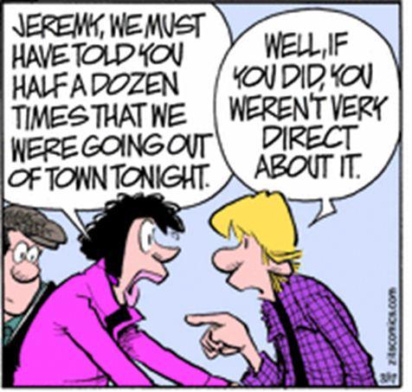
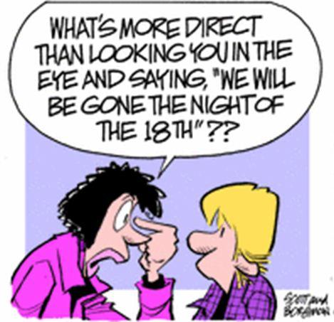
Communications 101

Slide 6

Communication
Communication is the activity of conveying meaningful information
The communication process is complete once the receiver has understood the sender.
Notes:
Non verbal
Visual
Oral
Written

Slide 7

Objectives
Importance of communication
Change perception
Promote your value
Align with department/company goals
Create a plan/policy
Leverage Social Media
Tools to get you started

Slide 8
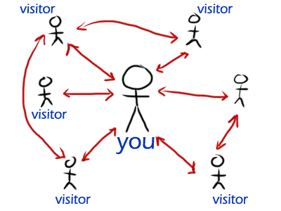
Importance
Who has a plan in place?
If no plan, is it consistent?
Are you aligned with your IT organization? Business?
Why have a plan?

Slide 9
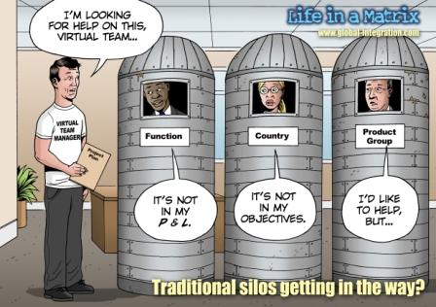
Importance
Why have a plan?
  Break down silos
  Create a shared vision
  Send one consistent message
  Proactive – Effective – Timely
Promote your value
  Clearly Articulated - IT services must be aligned to the needs of the business
Notes:
Clearly Articulated
Promoting your value: what service do you provide, why is your service of value? We keep systems running so you can continue to work in an efficient way by leveraging technology to increase your productivity and aligning our services with the business.

Slide 10
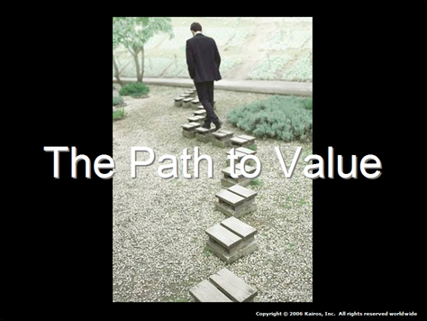
Importance
Value
Aren’t we selling something?
  Services
Does the customer know how to obtain your services?
Alignment
Is the business included in your planning?
Do they sit at the table?
Are there black out periods?
  i.e. Higher Education, Insurance, retail (Black Friday)

Slide 11
Perception - Do You Have a Plan?
Process to keep customer in the loop
Management support
Is communication aligned with;
  Service Level Agreements - SLA
  Underpinning Contracts - UC
  Operating Level Agreements - OLA

Slide 12
Modes and Methods
Newsletter
Email
Social Media
Web Site
Intranet/SharePoint
Phone Calls
Face to Face
Brown Bag Lunch and Learn
VoIP phones
30 second video clip
Notes:
Blog entries from CIO, IT Marketing Resource

Slide 13
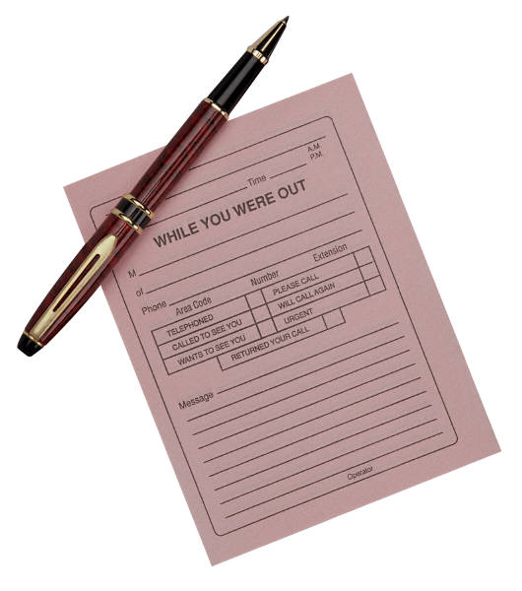

Who sends the message?

Slide 14
Implementing Plan
SPOM – IT Marketing Department
Who communicates your message?
  Liaison, Director
Who is the right person, what skills are required?
  Strong customer service
  Internal person familiar with organization
  Held several roles within the company
  IT leader within
Notes:
Reference: Jim Cross, Communications: Building and Maintaining Effective Business Relationships, July 28, 2011
http://www.castlepointe.com/20110728472/Driving-Business-Value/Communications-Building-and-Maintaining-Effective-Business-Relationships.html

Slide 15
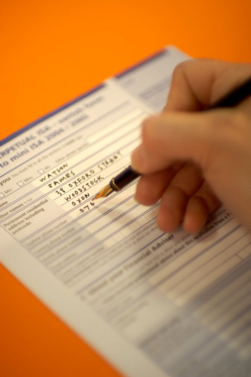
Implementing Plan
List of Approvers
List of Authors
Forms
Less people involved the better

Slide 16
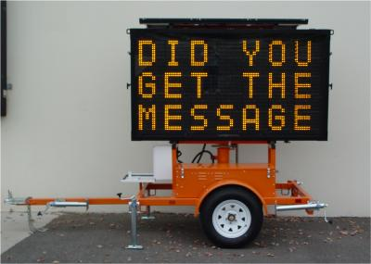
When to Send the Message
Reactive or Proactive?
How often is message sent?
Post mortem message
  Not too technical
  What happened
  How to prevent in future
Internal/External Customer

Slide 17
Types of Announcements
Maintenance
Scheduled Upgrades/Expected Downtime
Unexpected Downtime
Delivery of a new service
Training
Urgent/Non-Urgent
Internal/External
Notes:
Form used to communicate announcement

Slide 18
Communication Prioritization
Urgency | Impact
 |  | High | Medium | Low
 | High | 1 | 2 | 3
 | Medium | 2 | 3 | 4
 | Low | 3 | 4 | 5
Priority | Description
1 | Critical
2 | High
3 | Medium
4 | Low
5 | Planned
Code Red
Code Blue
Code Yellow
Code Green
Code Gray

Slide 19
Incident Management
Reactive
Impact MTTR
Choose template color code
Sender - SPOM, Liaison – Who?
Vehicle – How?
Reason – Why?
When is the message sent?
How often?
Who approves?
Code Red
Code Blue
Code Yellow
Code Green
Code Gray
Notes:
High Impact and High Mean Time to Repair, choose blue or red template depending urgency and priority
Sender – who is responsible for sending this message? Is it one person, a team or department?
Vehicle – VoIP, email, recording on queue, website, Social Media, SharePoint (intranet)
Reason - What does the message state? System outage, which system/app is affected, all users/which users (who), expected timeframe
When is the message sent?
How often is the message communicated?
Who approves the message?

Slide 20
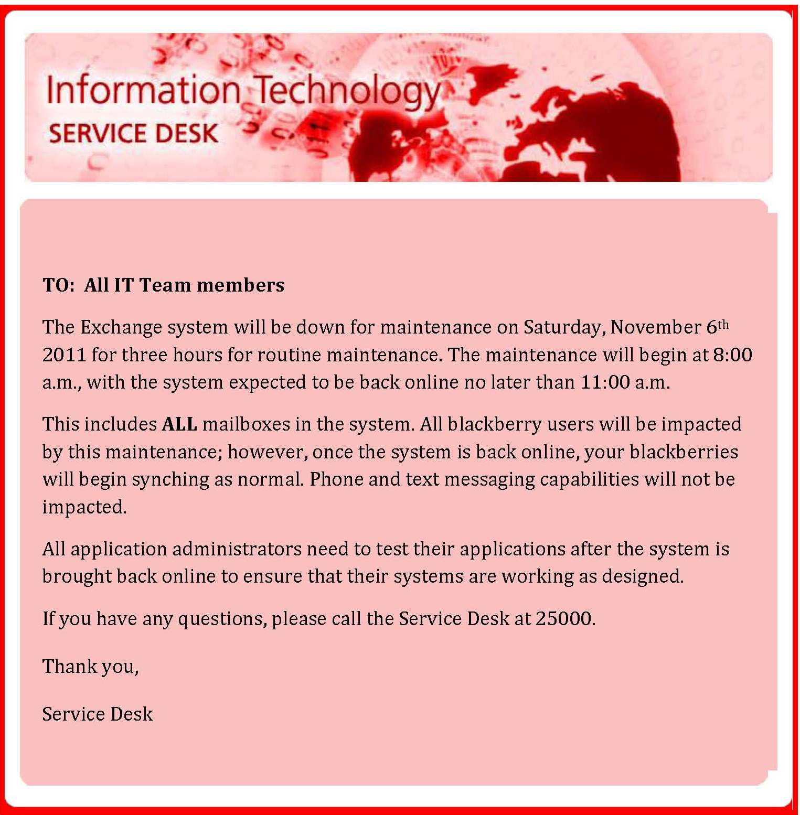
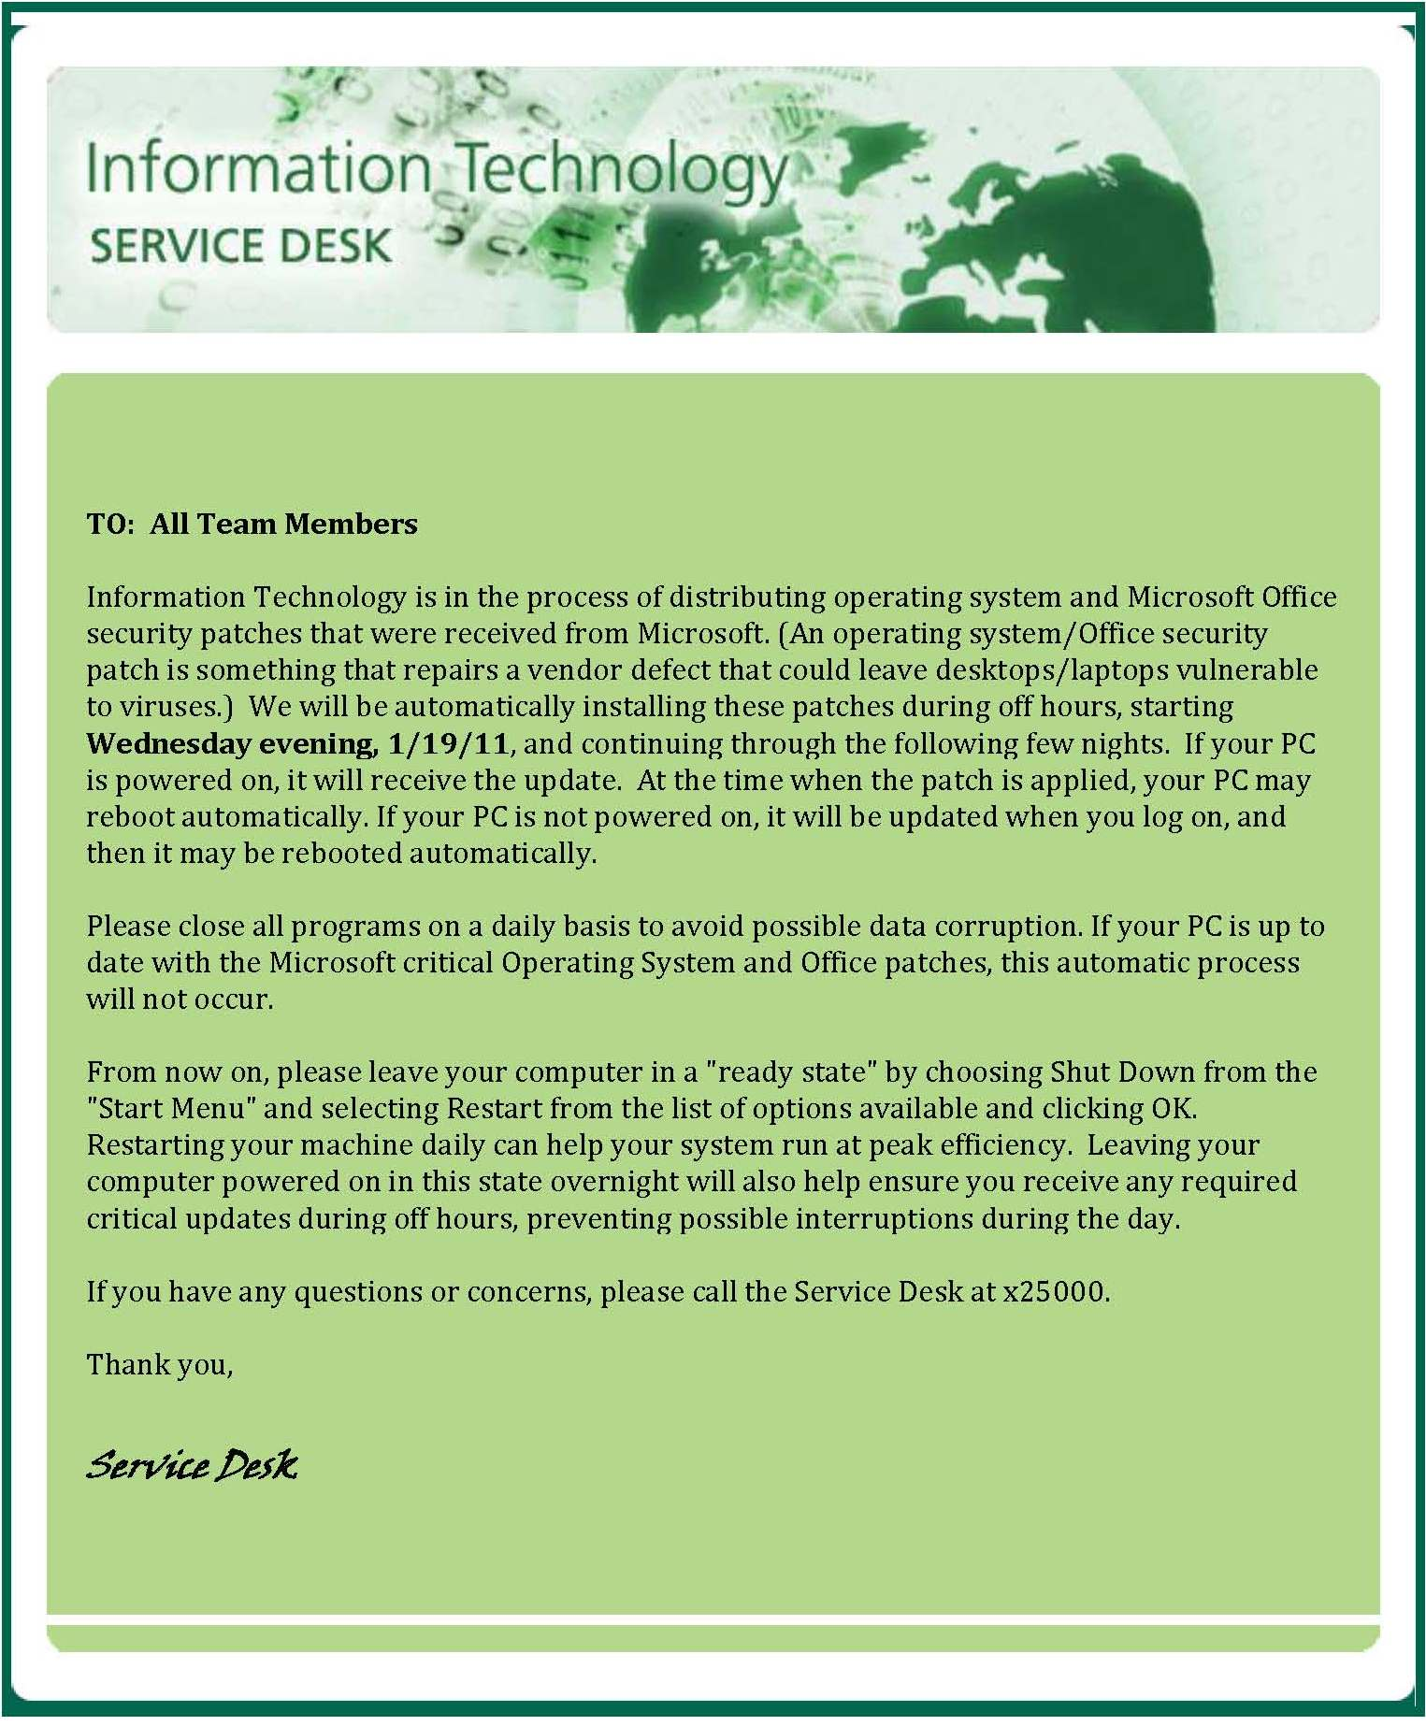
Examples
Courtesy of Cay Robertson, TECO Energy

Slide 21
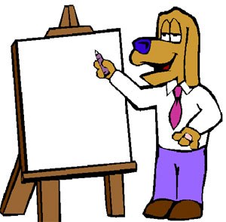
Examples
Learned system was down due to Twitter
Rollout and Upgrade
  Went great, VP was happy but didn’t know because it wasn’t communicated

Slide 22
Good, Bad and Ugly
Reactive Communication
Sweep under carpet
System down, no communication
Communicate because customer called in?
Repair relationships?

Slide 23
Message
To All Central Server Users,
Due to scheduled server maintenance, Central Server Services will be unavailable from 6:00PM Friday September 16th, 2011 through 8:00AM Saturday September 17th, 2011. If you have any questions, please call the IT Support Center at (305) 222-1234 option #3.
Notes:
Questions to ask for this type of message.
What kind of service is occurring, customer impact? How does the customer know what Central Server means? Is it access to their folders, can they still access their system? Contact number when ITSC is closed, does user leave a message? What happens if there is a problem?
Who sent this message? Who approved it? If the maintenance fails is there a backup plan? What changes will the customer see, do we share that with them on Monday, or better yet during the release of this message.

Slide 24
Message
Subject: Advisory
All efforts to restore service levels to normal have been unsuccessful. The vendor is requesting that the PBX is rebooted at 1:00 p.m. to prevent further widespread outages. It will take 3-5 minutes maximum for service to be restored after reboot. Please remind all Call Centers Agents to log back in. This does not pertain to Voice Over IP (VoIP) services. Ancillary services tied to the PBX may take longer to be fully restored.
If you have any questions, please contact the IT Support Center at 305 284-6565, or email us at itsupportcenter@dontcallus.com
Notes:
What service is down? It should have been stated in the subject line. Do we post this on the Alert IT web page? What outages are taking place? Acronyms are being used and the customer may not understand what this means. It also doesn’t define the impact to the service.
It’s say Medical but is this the only campus? I know we were having Communite issues earlier today.

Slide 25
Templates
What should they say?
  Purpose of message
  What system/application is being impacted
  How does it impact the customer
  When will the system be unavailable
  Questions, who to call?
Notes:
Business Communications
Scheduled Upgrades
Deployments with downtime

Slide 26
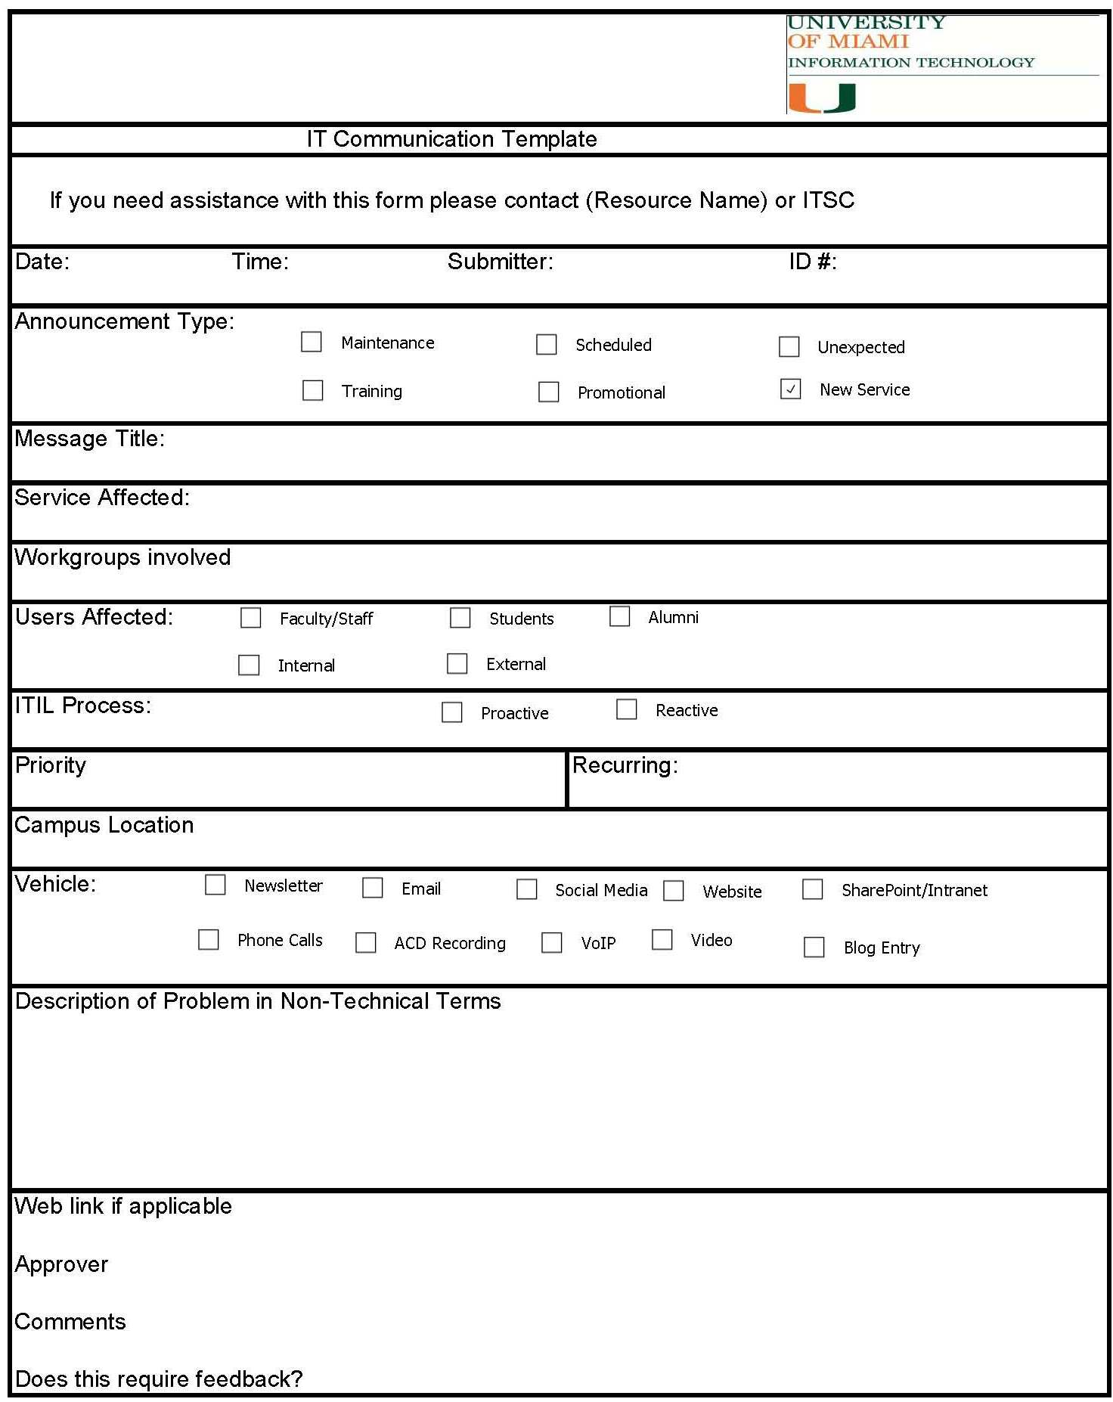
Form

Slide 27



Social Media
Facebook Fan Pages
  Downtime messages
  Maintenance
Twitter
YouTube
  Virtual tour of Service Desk
  Who is IT
  Spotlight on Employee
  Service Interruptions 30 second clip

Slide 28
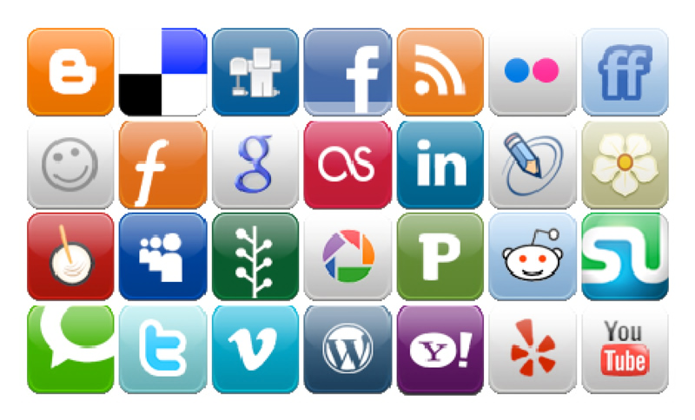
Social Media
Allows dialog
Allows the receiver to provide feedback
Poll question after message
Notes:
Most communication from IT is one way. We deliver the message when we want to and how we want to. Social media allows instant feedback and dialog. Feedback is good regardless of the response. Positive responses help your organization gain credibility and negative responses provide you the opportunity to response and turn it into a positive. In the past you would receive a phone call or letter from an unhappy customer.

Slide 29
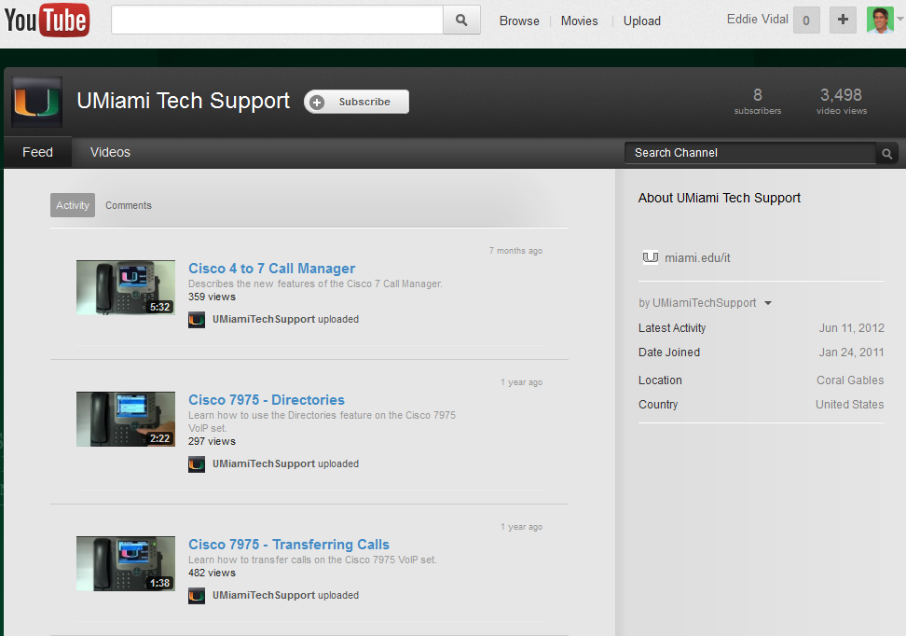
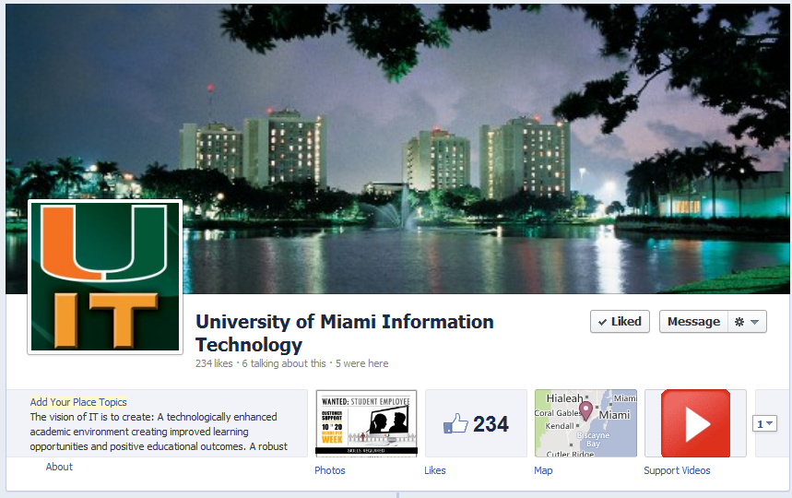
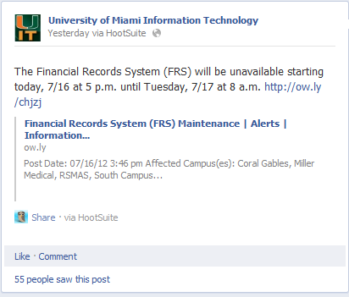
Social Media

Slide 30
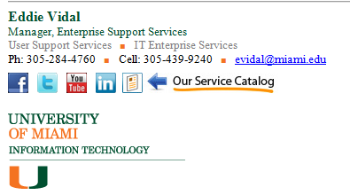

Consistency
Consistency in your communication
Sing the same song
Email signature
Support Center sign off, upsell

Slide 31
Summary
Don’t forget to promote your value to the business
All communication should not be due to outages
Think like a Marketing department
Promote success stories, new services, employees
Use surveys to reach out to your customer via Social Media, generate dialog
Use video clips of customers praising you
Consider publishing FAQ videos
Use available tools to post solutions to customers questions
Eliminate the “never told us”

Slide 32

Summary
Did you develop your plan internally, within IT?
Did you reach out to your customer to understand their expectations?
If not, what do you think you should do?

Slide 33
Eddie Vidal
HDI & Fusion Track Chair
HDI & Fusion Conference Speaker
HDI Member & Desktop Support Advisory Board
HDI Southeast Regional Director
President of South Florida HDI Local Chapter
Published in Support World Magazine
HDI Support Center Manager Certified
ITIL V3 Foundation & OSA Certified
itSMF Monthly Podcast Jockey & Producer
Manager, Enterprise Support Services
eddie_vidal@yahoo.com
evidal@miami.edu
305-439-9240
Notes:
Eddie Vidal
Manager, Enterprise Support Services
University of Miami
Eddie Vidal has over twenty years’ experience in information technology, where he focuses primarily on service delivery and support for IT infrastructures. In his current position as the manager of enterprise support services for the information technology department at the University of Miami, Eddie supports over 35,000 faculty, staff, and students. In addition to higher education, Eddie’s experience includes the hospitality and travel industries.
Eddie currently serves as the president of the HDI South Florida local chapter and a member of the HDI Desktop Support Advisory Board (DSAB). He has spoken at local, regional, and national events and has been published in HDI's SupportWorld magazine.

Slide 34

Thank You For Attending The Webcast!
Please take a moment to answer the quick survey after you exit the webcast. Your feedback is extremely valuable to us.
Peter McGarahan
President
McGarahan & Associates
We’d Love To Hear From You!
Phone: 1.877.581.3942
Email: Info@ThoughtRock.com
Thought Rock Live
Knowledge worth sharing
Thought Rock Live
Knowledge worth sharing
#TRLive
@ThoughtRockers
Thoughtrock.com

